Slide 1



AI Tinkerers Hackathon
Werecooked!
Fine-tuning Malaysian LLMs as Judges
bit.ly/werecookedai

Slide 2
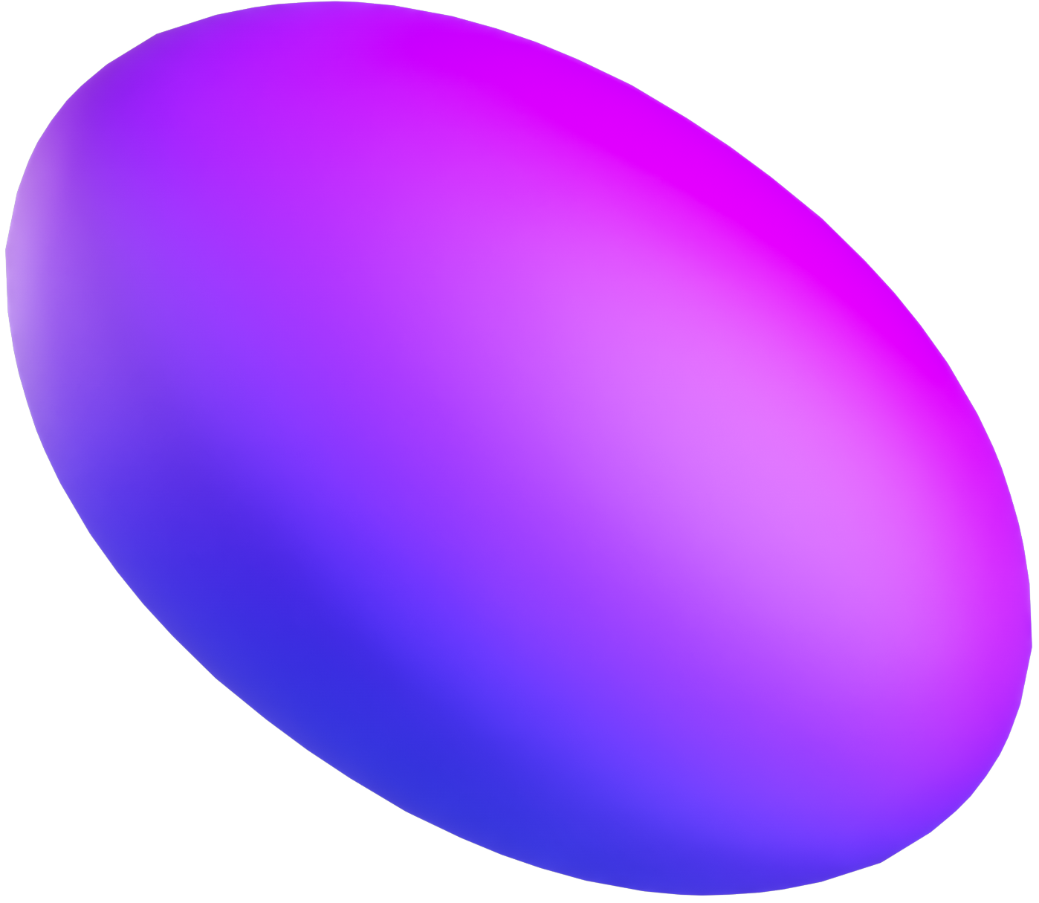
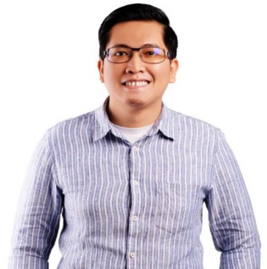
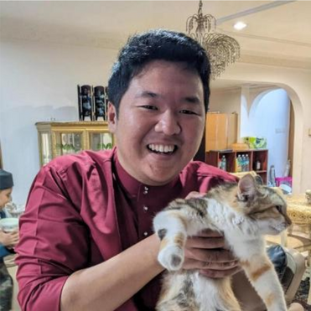

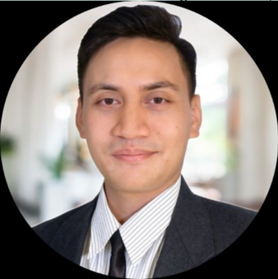

Meet the team
werecooked is a team composed of Data Scientists weary of tabular data and SQL. Hence, when work makes us dull boys, we like to have fun with LLMs where things are slightly less predictable. While our team name may sound Pessimistic, rest assured that we're always cooking (as the gen Z's would say) by messing around with the latest AI trends and always learning to pick up the latest tools available
Naqib Asri
Wan Adzhar Faiq
Ammar Azman
Fahmi Zainal
Sukhdev Singh
AI Engineer
Cloocus Sdn Bhd
Data Scientist
Maybank
Data Scientist
Amanah Saham
Nasional Berhad
Senior Data Scientist
INVOKE
Data Scientist
Maybank

Slide 3
Problem Statement
With the rise of AIs, LLMs have become an integral part of many industries.
However, in order to fully leverage these models, it isn’t just about deploying them. But it’s also about evaluating and refining hem to meet specific contextualised needs.
Traditional evaluation methods are outdated and ineffective at distinguishing high quality LLM responses from subpar ones.
While using human annotators gives great resuls, it requires significant effort and is difficult to scale across to multiple contexts.
An emerging solution is using LLM Evaluators AKA “LLM-as-a-Judge” which uses LLMs to evaluae the quality of anoher LLM’s response.
For this Hackathon, we have developed an LLM Evaluator that judges the consistency of a statement based on an input document

Slide 4
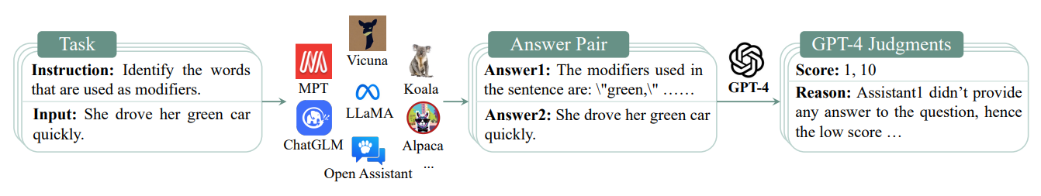
Motivation
We are inspired by BAAIVision’s work in employing LLMs as scalable judges for human preference. In our case, we’re looking to finetune judges for predicting logical/factual inconsistencies as well as answering yes/no questions.
More crucially, this paper also presents promising research where 7 Billion parameter models (which are much smaller) can approximate reasoning skills close to if not better than OpenAI’s GPT4. Let’s see if we can replicate this!

Slide 5
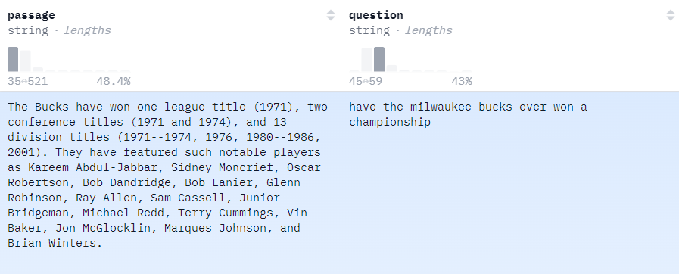
Dataset Preparation
We source our dataset from Google’s Boolq a question answering dataset for yes/no questions containing 15942 examples; and a dataset from the FIB benchmark consisting of 3579 examples for evaluating the factual inconsistency of large language models.
Both datasets are in English and useful for our use case in that they are binary. For boolq, we use it as the primary train/validation set due it being more.
To ensure our model has high quality Malay examples, we employ OpenAI’s 4o-mini to provide translation.
Sample 1 : Sample of a question-answer pair from Google’s Boolq

Slide 6
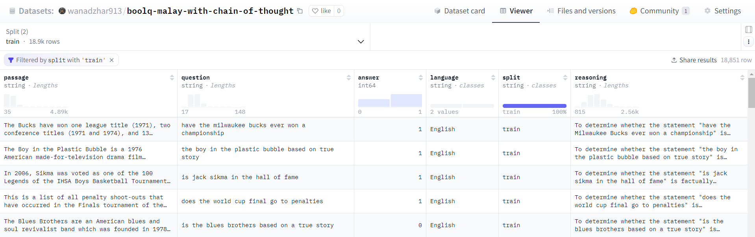
Dataset Preparation
Sample 2 : https://huggingface.co/datasets/wanadzhar913/boolq-malay-with-chain-of-thought

Slide 7
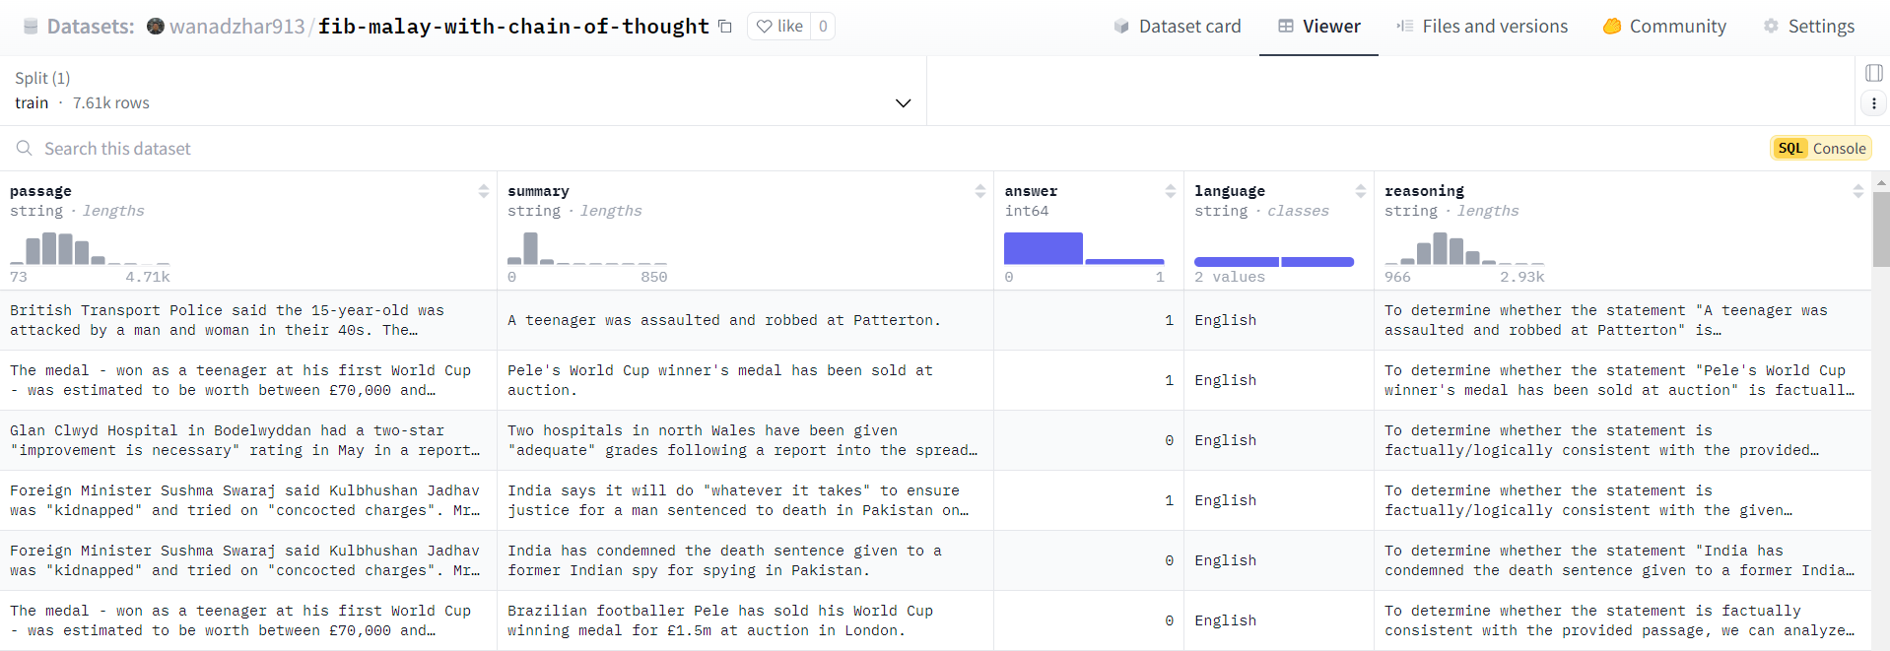
Dataset Preparation
Sample 3 : https://huggingface.co/datasets/wanadzhar913/fib-malay-with-chain-of-thought

Slide 8
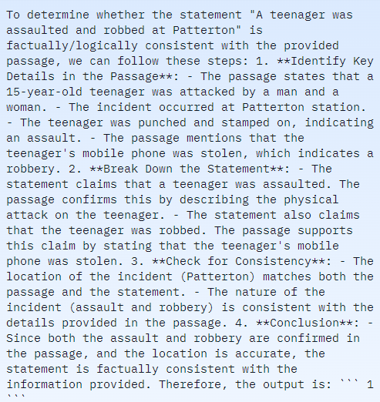
Dataset Preparation
We also generate a ‘reasoning’ column to enable smaller models to perform complex reasoning tasks using OpenAI’s 4o-mini.
Zhang et. al found that small models under Fine-tune-CoT can even outperform their very large teachers in some tasks. With diverse reasoning, the performance of Fine-tune-CoT was highly scalable and led to high sample efficiency and notable reasoning performance even with few-shot training examples.
Sample 4: Sample of Chain-of-Thought Reasoning generated using OpenAI’s 4o-mini

Slide 9
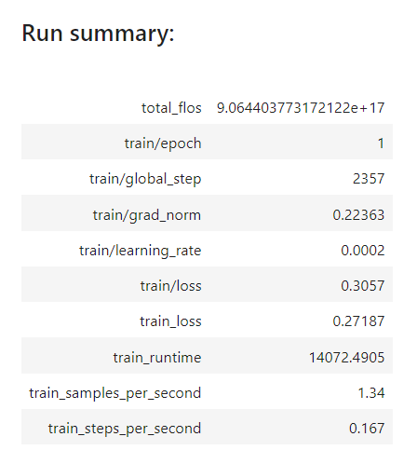
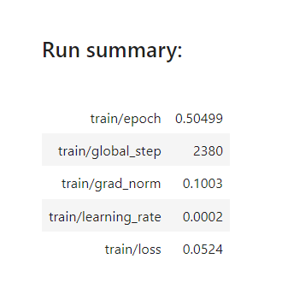
Finetuning
We employ Huggingface’s trl (Transformer Reinforcement Learning) for Supervised Fine-tuning and finetune Mesolitica’s https://huggingface.co/mesolitica/malaysian-mistral-7b-32k-instructions-v4 model
We train 2 models, one primarily focused on classification (V2) and the other on both classification and reasoning (V3).
Both models were trained on the following hyper-parameters. Training time/Epochs was intentionally different between the 2 models due to resource constraints (Google Colab compute credits). Due to V2 reaching a lower loss early, we decided to end it’s training prematurely at 0.51 epochs, while V3 received 1 epoch’s worth of training.
The Weights & Biases run for both models can be found here for V2 & V3.
A small batch size was used to avoid OutOfMemoryErrors although in the future, the gradient_accumulation_steps parameter should be increased as well.
Fig. 2 : The left is the training outcome for V2 and the right is for V3.

Slide 10
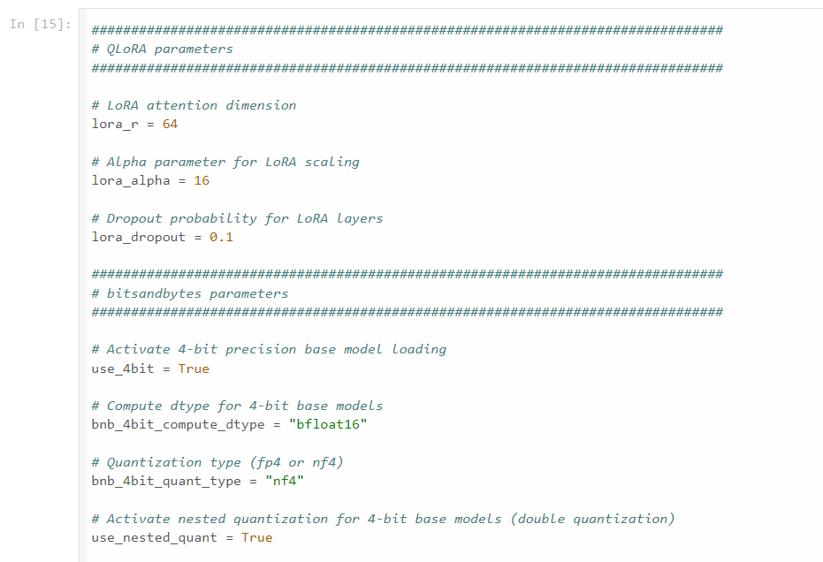
Finetuning
Very crucially, we load our model in 4-bit precision using BitsandBytes & train our model using QLoRA
(with a Rank of 64) to minimize memory usage during training.

Slide 11
Results
 | OpenAI 4o-mini | Finetuned-Malaysian-Mistral-V2 | Finetuned-Malaysian-Mistral-V3*
F1 | 80% | 74% | 69%
Accuracy | 78% | 65% | 61%
Precision | 83% | 65% | 69%
Recall | 77% | 85% | 70%
*While we did see better performance with V3 on selected examples, the overall score suffered due to V3's inability to consistently return JSON responses.
**The evaluation dataset was constructed by taking the first 200 samples from the evaluation set from Boolq-Malay & FIB-Malay dataset.

Slide 12
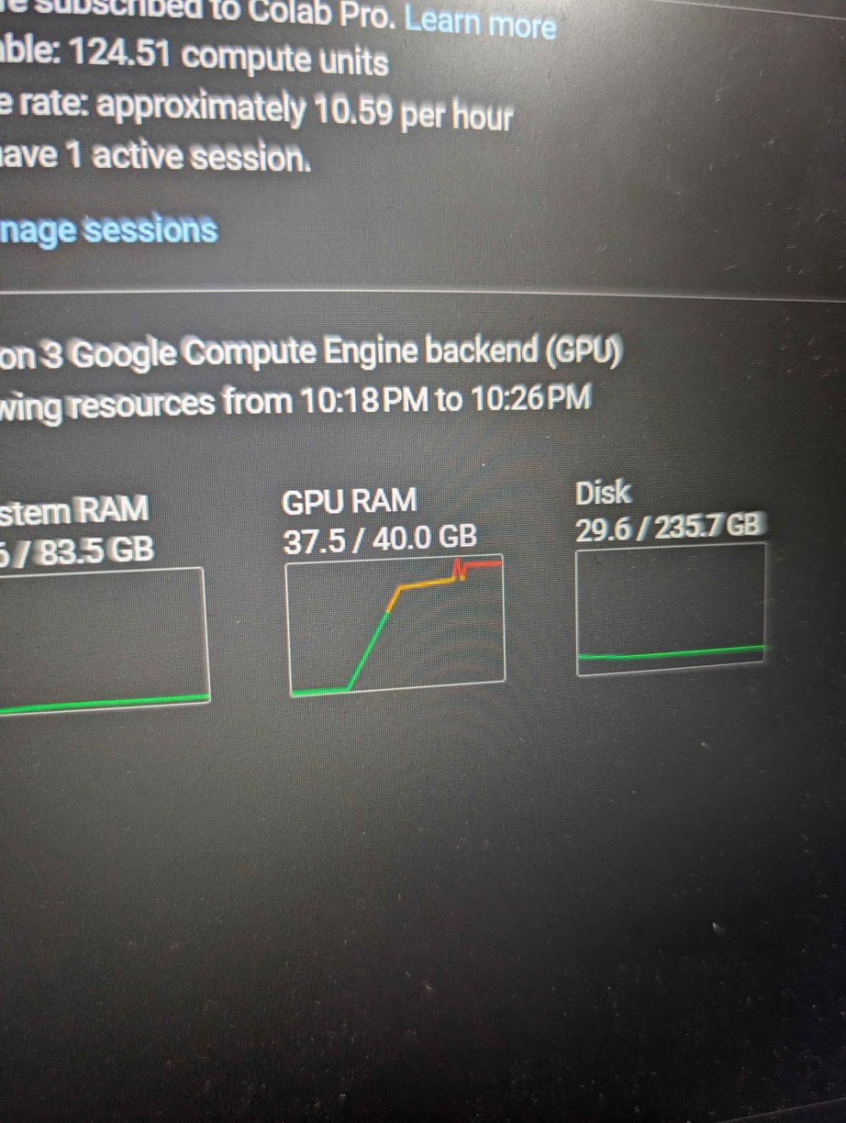
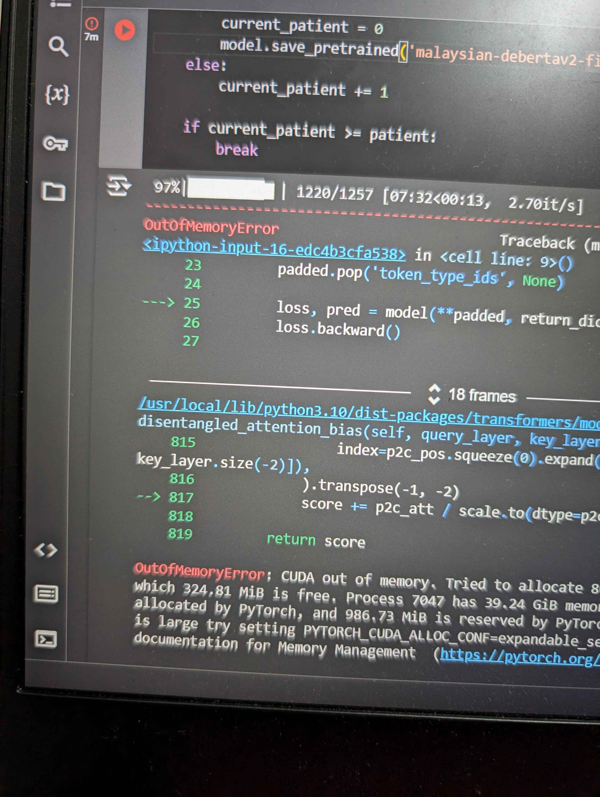
Challenges Faced
We encountered largely centred around compute. Google Colab Pro’s single A100 40GB GPU is still very small even after loading the model in 4-bit precision.
Fig. 3 : You can already imagine the horror on our faces as we saw these prints

Slide 13


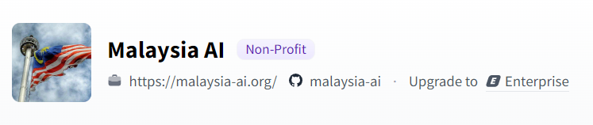
Thank you!
Joseph from DocuAsk too for the guidance and OpenAI credits :)
Especially to Mesolitica and Malaysia AI
for open-sourcing their models. In the same spirit, we’ve done the same in open-sourcing our datasets, and models for greater scrutiny and use as well.

